Slide 1



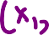














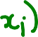

Slide 2
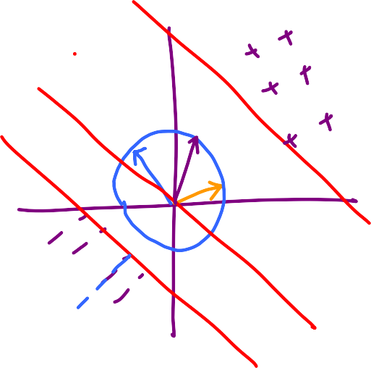

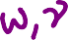


Slide 5
x₂
[0.5 2.5]
[1/3 1/3]
[1 1]
x₁
x₁ + x₂ = 3
(1/3)x₁ + (1/3)x₂ = 1
[-0.5 -2.5]
x₁ + x₂ = -3
(1/3)x₁ + (1/3)x₂ = -1

Slide 6
x₂
[0.5 2.5]
x₁ = -0.5
(2)x₁ = -1
[1 0]
x₁
[2 0]
x₁ = 0.5
(2)x₁ = 1
[-0.5 -2.5]

Slide 7
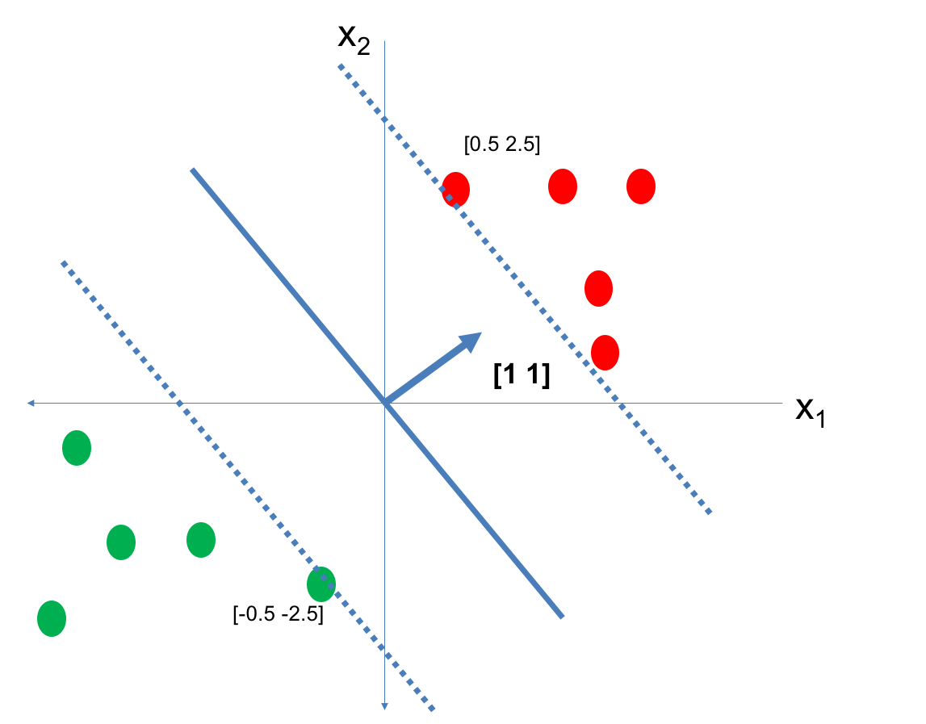
Notice what happens
to the lengths
of the w as we
adjust it to have
margin 1

Slide 8



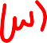

OBSERVATIONS
-> Once a direction is fixed,
the width between the margin lines
is fixed
-> If the width is large, then the w that
achieves margin 1 in that direction
has smaller length
-> If the width is small, then the w that
achieves margin 1 in that direction
has larger length
-> In general, width(w) seems to be
inversely proportional to length(w)

Slide 9

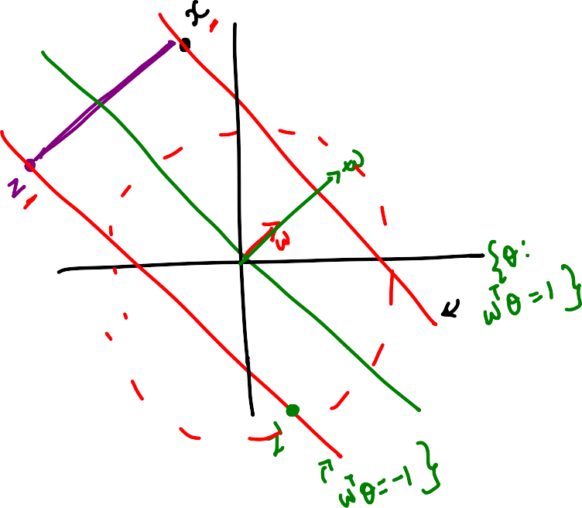








Slide 10
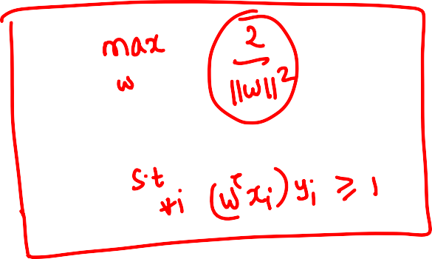

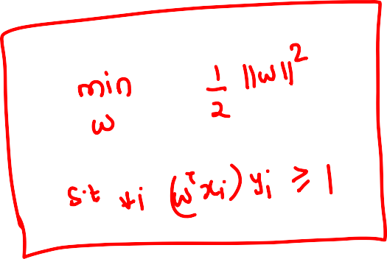


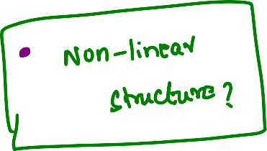

Slide 11


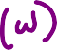







Slide 12





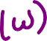



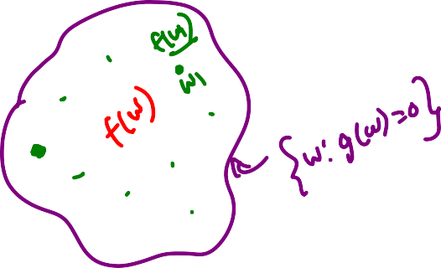




Slide 13
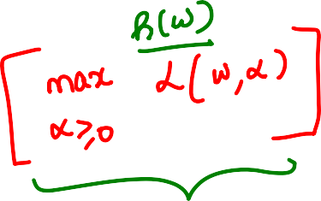





Slide 14

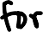
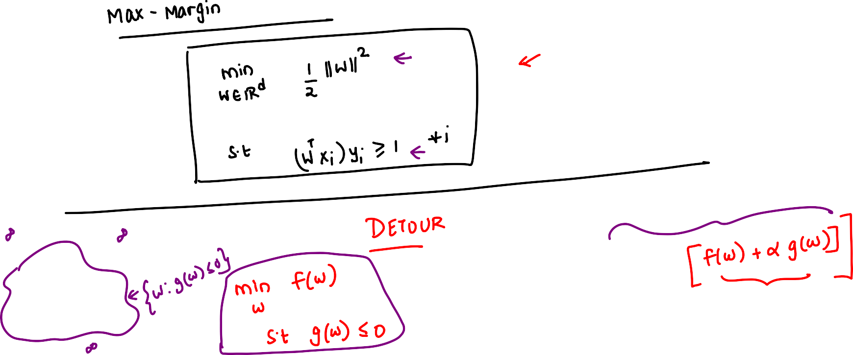

Slide 15
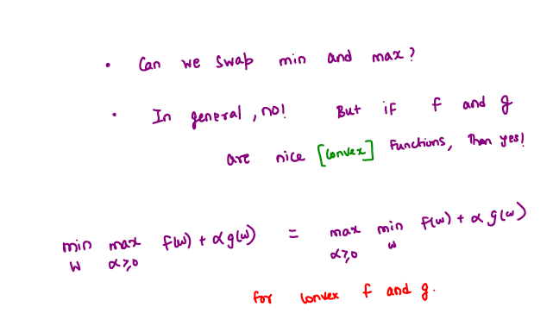

Slide 16



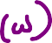
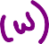


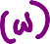




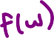


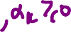

Slide 17
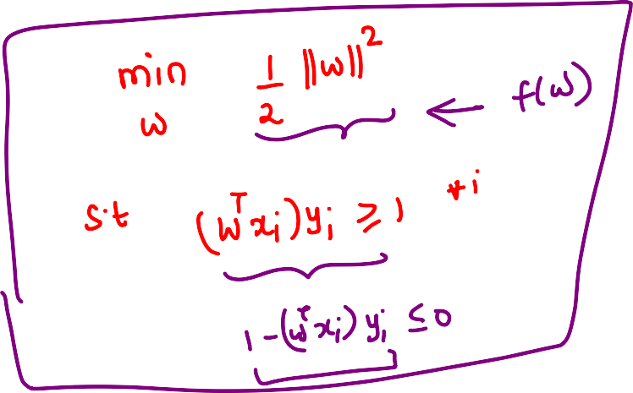
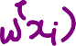





Slide 18
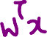










Slide 19
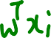




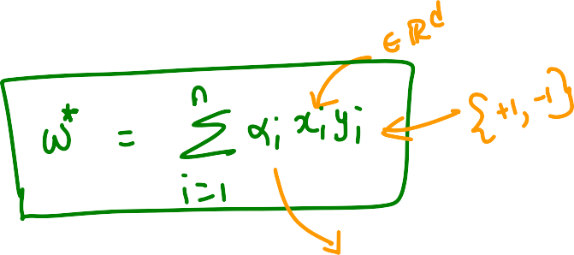



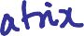



Slide 20
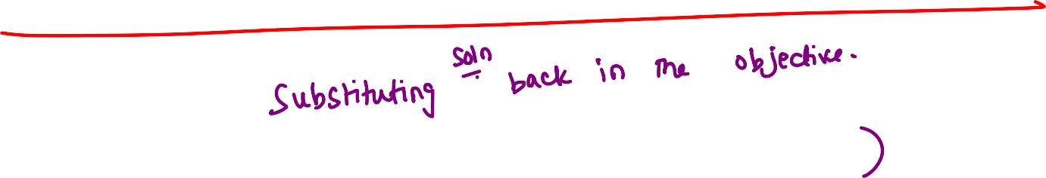

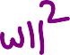
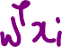




Slide 21
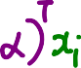









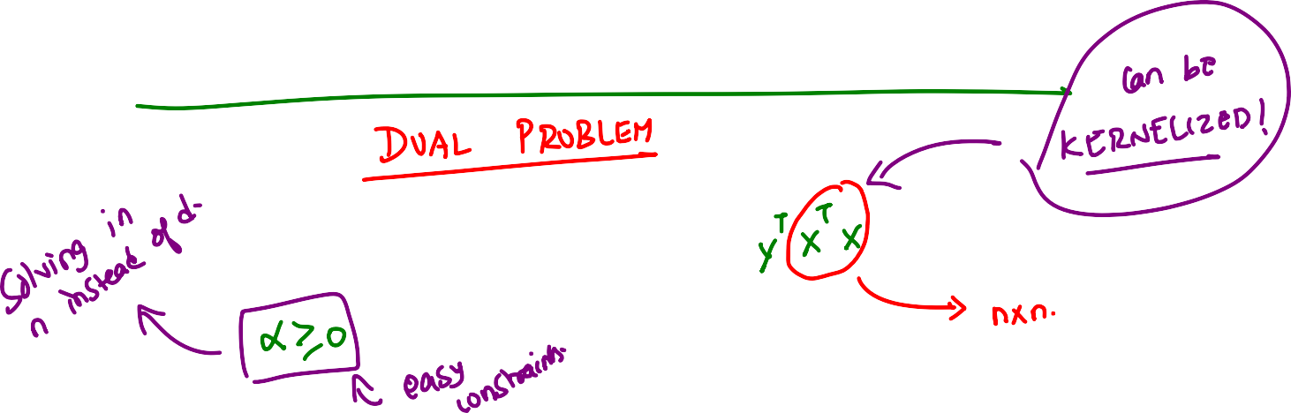





Slide 22


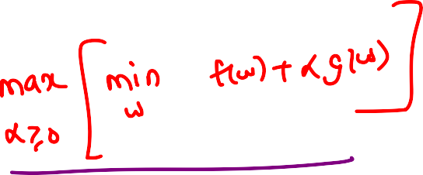
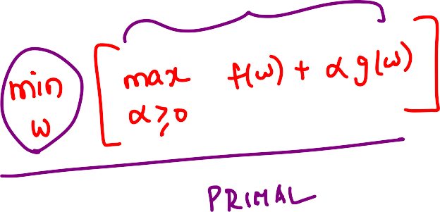



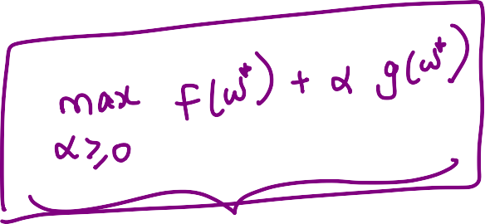

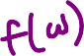

Slide 23






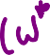
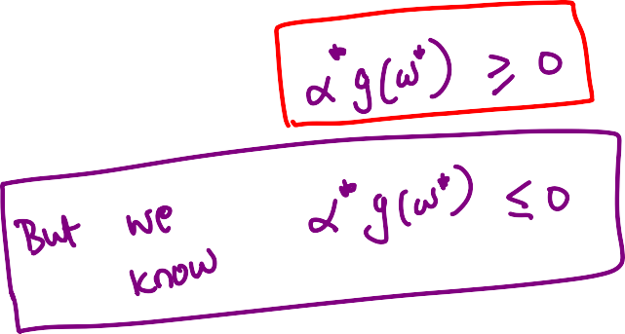








Slide 24



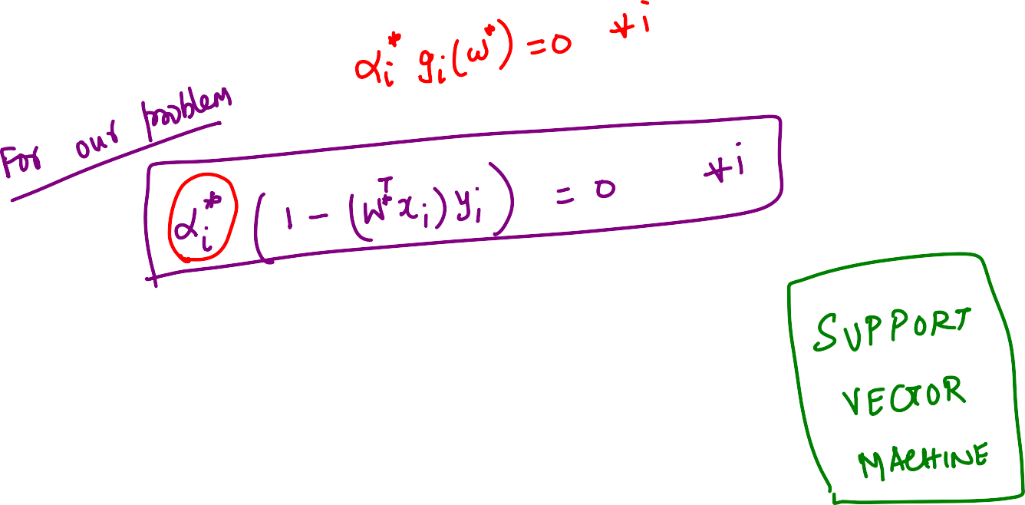
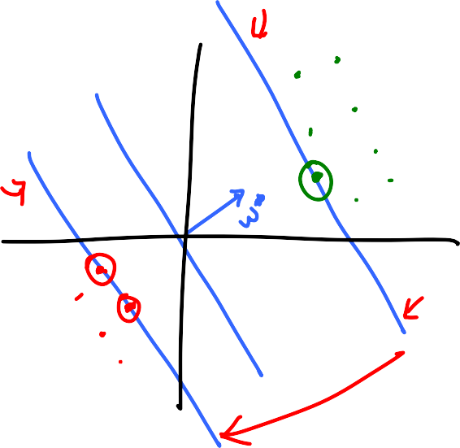




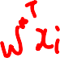



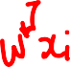

Slide 26
So far
Support Vector Machines
Primal Problem – Margin Maximization
Dual Problem
- Kernel Version
Now
- What if there are outliers in the problem?

Slide 27















Slide 28

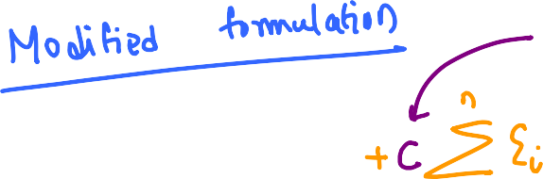

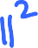




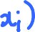

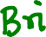






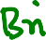




Slide 29



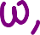












Slide 30









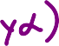

Slide 31









Slide 32









Slide 33



Slide 34














Slide 35













Slide 36















Slide 37



















Slide 38
















Slide 39















Slide 41


Slide 42





Slide 43




Slide 44



Slide 45




Slide 46





Slide 47



Slide 48



Slide 49














Slide 51





Weak classifiers
Overfit decision tree
…
high bias, low variance
……………
low bias, high variance

Slide 52












Overfit
decision trees

Slide 53



















Chance that a point
appears in a
dataset

Slide 54










Feature bagged decision trees -> RANDOM FOREST

Slide 55

















Slide 56






















Slide 57
x₂
[0.5 2.5]
[1/3 1/3]
[1 1]
x₁
x₁ + x₂ = 3
(1/3)x₁ + (1/3)x₂ = 1
[-0.5 -2.5]
x₁ + x₂ = -3
(1/3)x₁ + (1/3)x₂ = -1

Slide 58
x₂
[0.5 2.5]
x₁ = -0.5
(2)x₁ = -1
[1 0]
x₁
[2 0]
x₁ = 0.5
(2)x₁ = 1
[-0.5 -2.5]

Slide 59
Notice what happens
to the lengths
of the w as we
adjust it to have
margin 1

Slide 60
OBSERVATIONS
-> Once a direction is fixed,
the width between the margin lines
is fixed
-> If the width is large, then the w that
achieves margin 1 in that direction
has smaller length
-> If the width is small, then the w that
achieves margin 1 in that direction
has larger length
-> In general, width(w) seems to be
inversely proportional to length(w)

Slide 78
So far
Support Vector Machines
Primal Problem – Margin Maximization
Dual Problem
- Kernel Version
Now
- What if there are outliers in the problem?

Slide 103
Weak classifiers
Overfit decision tree
…
high bias, low variance
……………
low bias, high variance

Slide 104
Overfit
decision trees

Slide 105
Chance that a point
appears in a
dataset

Slide 106
Feature bagged decision trees -> RANDOM FOREST

